Slide 1
Digital philately and the collector opportunity or threat?
A presentation by Paul Redhead
Secretary of the West Africa Study Circle

Slide 2
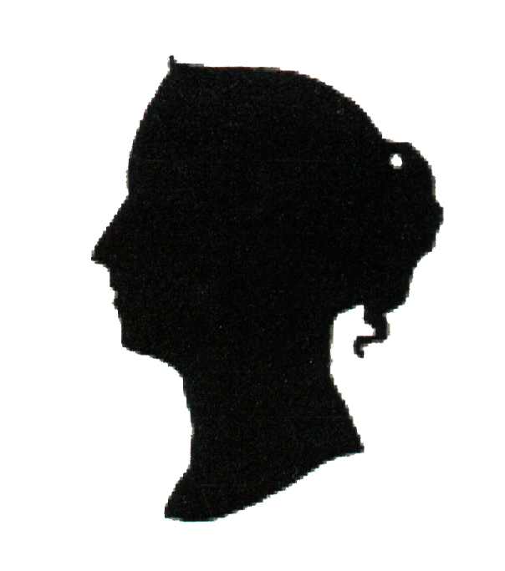
Introduction
How do we stamp collectors react to digital stamps, and how might that help postal authorities in making decisions about their own digital opportunities?
WASC, the West Africa Study Circle
dedicated to the study of West African philately
75th anniversary this year
Just over 200 members
Proud to have active members in Nigeria and a good relationship with NIPOST
But the views in this talk are just my personal opinions!

Slide 3
What do we mean by philately?
‘Philately, the Art of collecting, studying, and keeping of postage stamps and other artifacts of postal history has grown over the years from a mere hobby to become a multi-billion dollars business across the world. Moreover, it has succeeded in adding values to the global postal services, not only in revenue generation, but also in the area of promotion of global heritage, values and social interactions’
The Nigerian Philately Policy, published by NIPOST in 2015

Slide 4

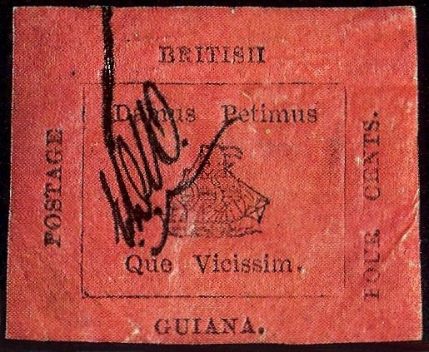
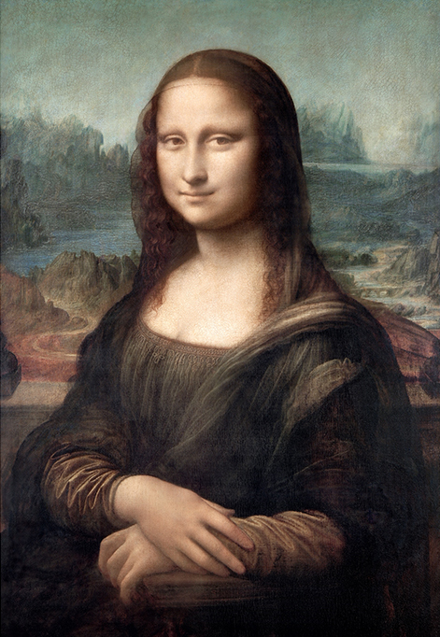
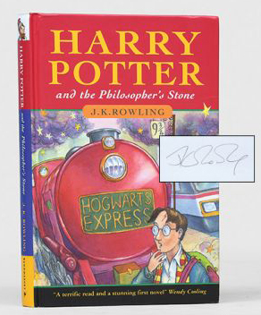
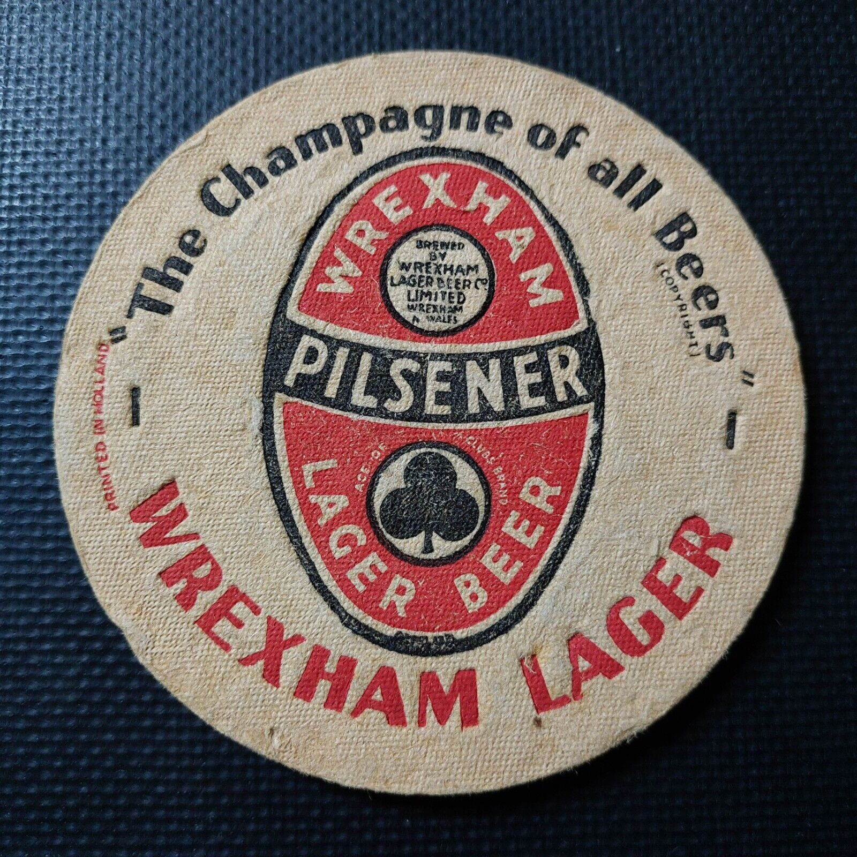

People love to collect

Slide 5
What drives collectors?
A good collectible rings most of these bells!
Ownership: to have something, to hold it, to look at it.
Aesthetic pleasure: in appearance, the quality of design and execution
Investment: the hope that value will rise.
Competition: to have the ‘best’ and to show it off
Thrill of discovery: finding something rare
Completion: "I’ve got the whole set".
History: objects reflect stories of why they were made and who made them

Slide 6
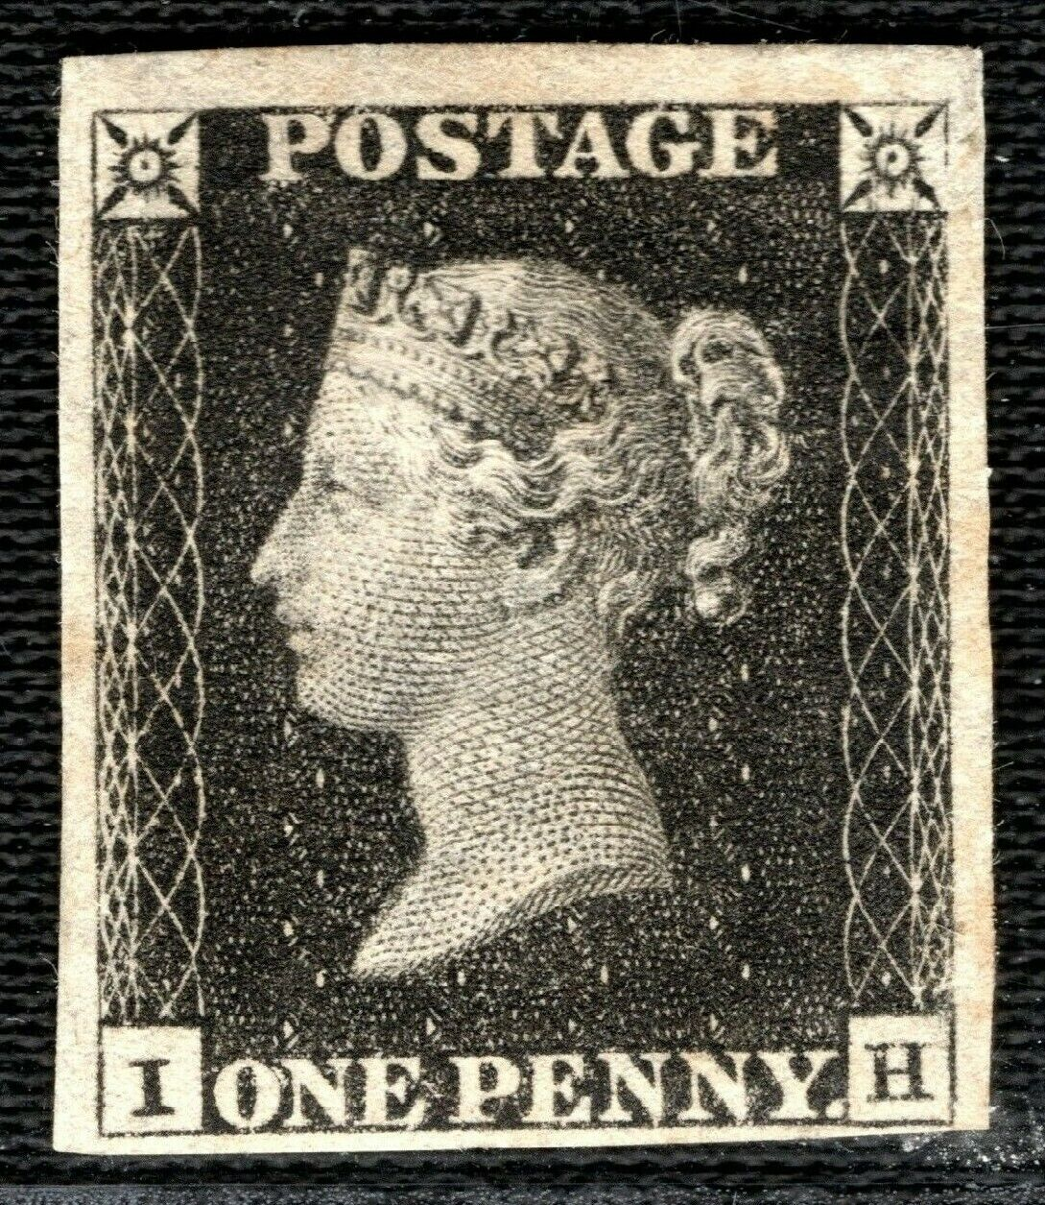
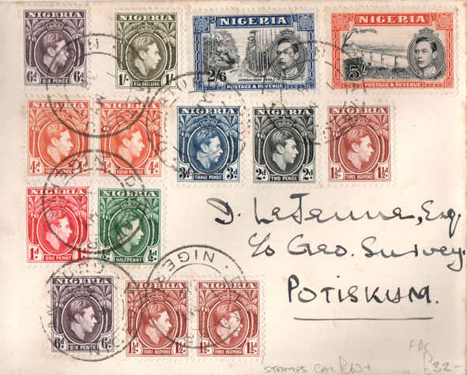
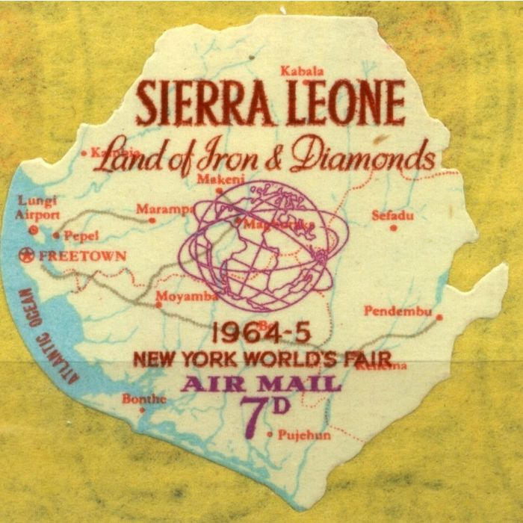
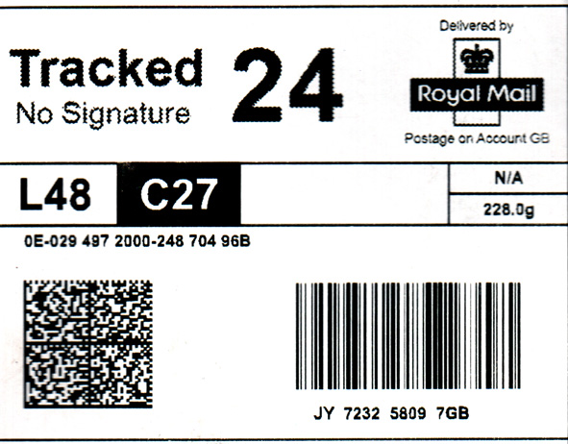
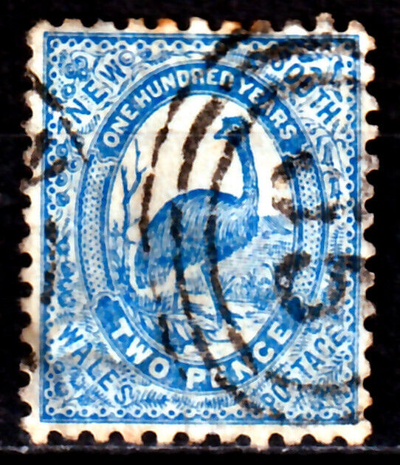

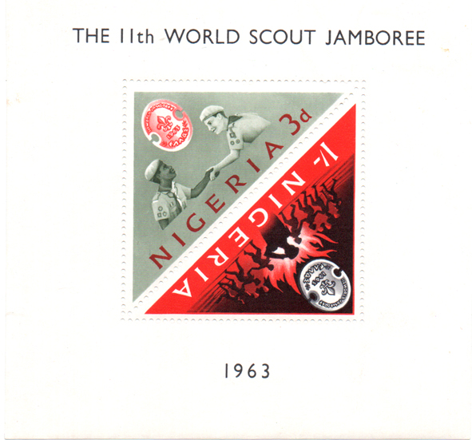
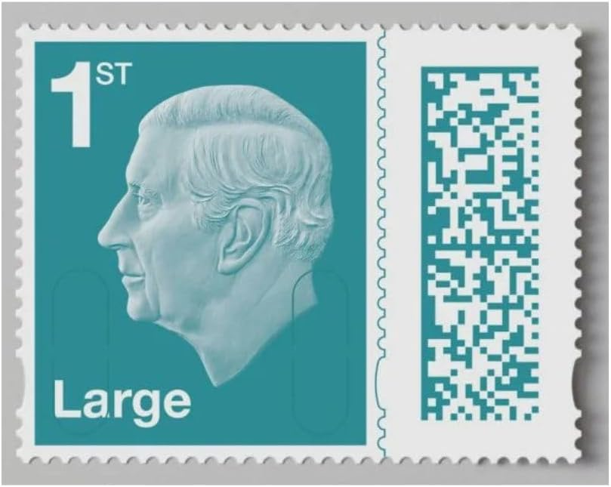
Stamp collectors – a conservative bunch?
Yes and no. Look at how collectors have welcomed innovation over the years

Slide 7
Three sorts of stamp collector
The young collector:
  Collects all world, enthusiastic, likes the pretty stuff
  Not much money
  Often stops in teen years
The older collector
  May have collected as a youth
  Now has time and money
  Likely to specialise
  May be more conservative
The new tech-savvy investor
  Very open to new technology
  Has money and interested in making more
  May or may not be interested in postal matters

Slide 8
Collectors and digital philately 1
The young collector is a vital part of the philatelic picture. Many specialist collectors return to the hobby they started as youths.
Also important: the inspiration and educational role that stamps can play for young people introducing new worlds in geography, history, culture and natural history. Stamps can play a part in education and in building national pride.
Crypto stamps can add another dimension of interest but they generally cost more than the young collector can afford !

Slide 9
Collectors and digital philately 2
The older collector may be willing to spend a lot of money on philately. He or she (mostly he) is not necessarily conservative, but is likely to see the crypto world as risky. He is likely to want digital stamps to have close links to real postal usage, but may well consider them as worth attention if they align with his specialism.
Digital products involving block-chain, NFTs, crypto-currencies, virtual wallets etc are not necessarily difficult to understand and use, but the technology can provide a learning barrier which older collectors are less willing to spend time to overcome, or to see the benefit of.

Slide 10
Collectors and digital philately 3
The new tech-savvy collector is likely to be excited by the crypto-world, and the well publicised news of NFT items, bought for hundreds, selling for millions. He or she is not scared by the technology involved, and is perhaps more willing to risk.
Stamps, with their artistic and cultural provenance, provide a valid vehicle for NFT-based offerings, but is investing in an NFT likely to produce an abiding interest in philately itself? I am doubtful. Expecting a serious revival in philately from this source is surely over-optimistic.

Slide 11
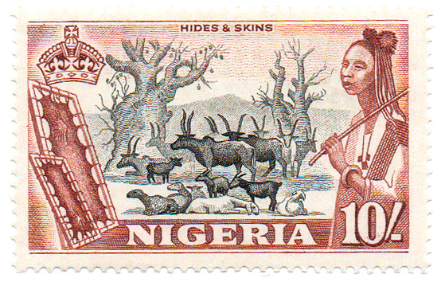
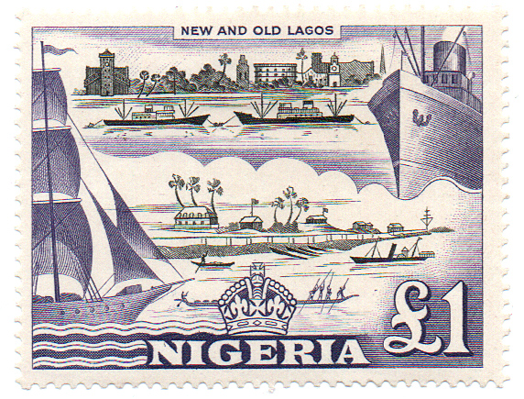
Collectors and digital philately 4
Would I be interested in a digital product? I am squarely in the ‘older collector’ bracket. I am cautious about crypto and the palaver of ‘Ether’ or ‘Matic’, and setting up a crypto wallet. I also like to handle and admire the stamps I collect.
But I could be interested in the right product, especially art-work based. The iconic Fievet designs for the Nigeria 1953 QEII set might make excellent digital offerings…
But would I buy a NIPOST cryptostamp which does not have direct connection to Nigerian postal service? No thanks!

Slide 12
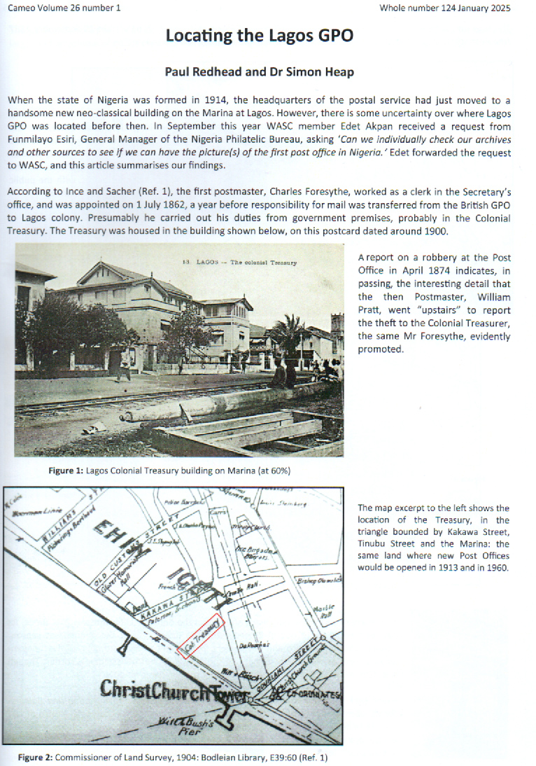
Collectors and national philatelic services
Good contacts help both sides! It is excellent that collectors are recognised as stakeholders in NIPOST’s philatelic policy. WASC values its contacts with NIPOST, and has been able to help, for instance with comments on stamp design, and research on postal history. I hope we can also provide useful input on stamp issuing policy.
Modern electronic communications and alternative delivery services have placed so many financial and operational pressures upon postal services.
Revenue is in short supply, and we support the exploration of extra sources of income. Digital stamps must be on the agenda, and I would like to offer a collector perspective on the opportunities and pitfalls that offering digital stamps can provide.

Slide 13
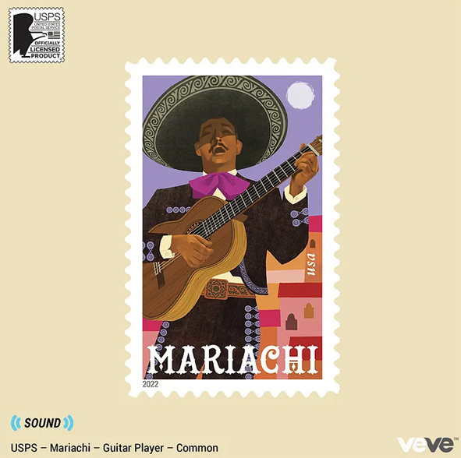
Potential benefits
Extra revenue: Can digital stamps bring extra revenue? Potentially “yes”, provided they can be produced profitably and are effectively marketed. That requires making good choices between all the various formats available, and an effective marketing campaign to reach collectors and investors. Pricing has to be sensible, and we would suggest that the offering should not require crypto-savvy for the initial purchase. Making use of philatelic legacy design is a good place to start.
More engagement: Generating interest and excitement through clever marrying of good design and the added-values made possible with digital technology, will bring in new collectors and can help fulfil the mission to educate and promote national identity.
Greater operational efficiency: Some aspects of digital, such as QR codes, enable better sender to recipient tracking, with greater transparency and trust in postal services. However, the cost of the equipment to enable this may be prohibitive.
Cote D’Ivoire crypto stamp design from legacy
USPS partner
with VeVe on new issue

Slide 14
Potential pitfalls
Wrong product: There are many options for publishing cryptostamps, in terms of what is provided, inducements, pricing, tie-in with postal services, marketing arrangements, who to partner with etc. It is unlikely that the big money days of early NFT will repeat, and so choosing the target market and product is vital for success
Mixed messaging: The range of possible products can create confusion for the purchaser: “Can it be used for postage?”, “Do I need Bitcoin to buy it?’, “what am I getting for my money?” are just some of the questions that marketing has to make clear, even for tech-savvy customers.
‘Eye off the ball’: Philatelic services generally have limited resources, and there is a risk that the complexities and novelty of crytostamps will take attention away from day-to-day business. There will be an ‘opportunity cost’ involved not just in terms of time and money, but also perhaps in other aspects of philatelic outreach – will engagement with young collectors be overlooked for instance?

Slide 15
And finally…
Thank you for listening. And thanks to PAPU and NIPOST for giving me the opportunity to address you.
With very best wishes for the future.
Paul Redhead
WASC

